Slide 1

PROJECT PRESENTATION ON OPTIMIZATION OF PATH TRAVELLED BY USING META HUERESTIC METHOD(GENETIC ALGORITHM)
PRESENTED BY:
Akash sharma(1805240005)
Vivek Madeshiya(1805240064)
Rudra Patel (1805240035)
Rishu Patel (1805240034)
Subhash Viswakarma (1805240052)
UNDER GUIDANCE OF:
Guide: Mr. Arun Mital
Co- Guide: Mr. Vipul Kumar Pathak

Slide 2
CONTENTS
OBJECTIVES
BACKGROUND
STEP BY STEP PROJECT EXECUTION AND ROLE OF EACH GROUP MEMBERS IN PROJECT
PROBLEM IDENTIFICATION AND MATHEMATICAL MODELLING
DISTANCE ALGORITHM EXECUTION
GENETIC ALGORITHM EXCEUTION
ANALYSIS AND OTPTIMIZATION OF ALGORITHM
BUILDING USER FRIENDLY INTERFACE
APPLICATION OF OUR PRODUCT IN REAL WORLD PROBLEM
FUTURE PLAN FOR OUR PROJECT
REFERENCES

Slide 3
OBJECTIVES
To identify to problem involved in decision making while touring and mathematical modeling of touring problem.
To identify the suitable solution that could be utilized by industry(as well small enterprises),provide limited resources and time.
To create a user friendly software which provide fairly optimum solution to improve to the decision making and enhance overall profitability of operation.

Slide 4
Step by step project execution and role of each group members in project
1. Problem identification and mathematical modelling
In this step we identify the problem and explore for various solution for our
problem ,identify pros and cons of each approach and selected the suitable approach
All group members
2. Distance algorithm execution
Implementation of distance finding algorithm with help of geographical coordinates .
Rudra patel , Subhash Viswakarma
3. Genetic algorithm execution
In this phase we developed various function like gene , crossover, elitism, mutation etc. to properly execute genetic algorithm
Akash sharma , Vivek Madeshiya ,Rishu

Slide 5
4. Analysis and optimization of genetic algorithm for desire purpose
In this phase we analyze the algorithm developed by us to find out what configuration will be most suitable for purpose
Rudra patel , Akash sharma
5. Building user friendly interface
In this phase we develop user friendly interface for our product, a python based pc application and a webpage
Vivek Madeshiya, Rishu patel
6. Using the developed product, finding optimum solution of some of the real world problem
Using the developed product, finding optimum solution of some of the real world problem
Subhash Viswakarma , Vivek Madeshiya

Slide 6


1. Problem identification and mathematical modelling
In this step we identify the mathematical problem associated with our project
Delivery person inputs the delivery location
machine generates optimum solution
Tour optimization software

Slide 7
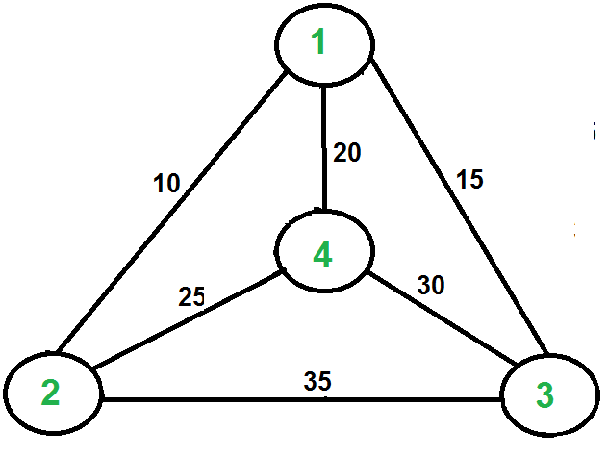
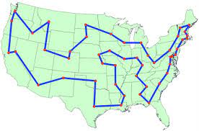
COMPLEXITY
The number of possible paths for n nodes are (n-1) !
That means for 51 node the number of possible paths are 50 ! , which is equal to 3.0414093 x 10⁶⁴ ,which is very big number (earth has only 7.5 x 10¹⁸ grains of sand),than for each possibility we have to add 50 distances ,than compare each to them to find the best route .
It will require very big space also very high computational power to solve this .

Slide 8
The problem in hand is similar to the “Travelling sells man problem “ which was proposed in late 1950s.
The travelling salesman problem (also called the travelling salesperson problem or TSP) asks the following question: "Given a list of cities and the distances between each pair of cities, what is the shortest possible route that visits each city exactly once and returns to the origin city?
It is an NP-hard problem.
we studied various approaches to solve this problem, which can be executed and can be utilized with in limited frame of resource .

Slide 9
SOLUTIONS
1) Exact algorithms:The most direct solution algorithm is a complete enumeration of all possible path to determine the path of least cost. However, for n cities, the problem is O(n!) time, and this method is practical only for extremely small values of n.
2) Heuristic algorithms: the TSP is an NP-hard problem, heuristic algorithms are commonly used to give a approximate solutions that are good, though not necessarily optimal.
 | ACCURACY | TIME
EXACT | 100 % ACCURATE RESULT | TAKES O(n!) time
HUERISTICS | VERY CLOSE TO ACCURATE RESULT | Takes polynomial time

Slide 10
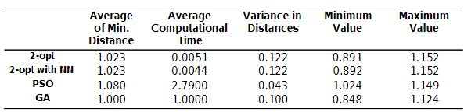
Comparison in various heuristic methods while solving TSP
Since in all of the heuristic method genetic algorithm gives the shortest path we choose genetic algorithm in our project.
the Comparison of Approximate Approaches to Solving the Travelling Salesman Problem -Anoop Sathyan, Nathan Boone and Kelly Cohen

Slide 11
ASSUMPTION INVOLVED WITH SOLUTION
It is assumed that aerial distance between two places is directly proportion to distance between them on ground .
It is assumed that all the locations are well connected i.e. there is no isolated place on over map.
It is assumed that traffic ,road conditions are same on every path.
It is assumed that cost and time to travel between two locations is proportional to distance between those .

Slide 12
2. Distance algorithm execution
In this step we executed a program to find distance between two place on earth by using their geographical co-ordinates
For this purpose we use Haversine method.
The Haversine formula calculates the shortest distance between two points on a sphere using their latitudes and longitudes measured along the surface. It is important for use in navigation. The haversine can be expressed in trigonometric function as:
where r is the radius of the earth(6371 km), d is the distance between two points, is the latitude of the two points, and is the longitude of the two points respectively.

Slide 13

Solving d by applying the inverse haversine or by using the inverse sine function, we get
This method provide result upto accuracy of 99% accuracy .

Slide 14
3. Genetic algorithm execution
Few important terminology related to genetic algorithm
Gene: a city (represented as (x, y) coordinates)
Individual (aka “chromosome”): a single route satisfying the conditions above
Population: a collection of possible routes (i.e., collection of individuals)
Parents: two routes that are combined to create a new route
Mating pool: a collection of parents that are used to create our next population (thus creating the next generation of routes)
Fitness: a function that tells us how good each route is (in our case, how short the distance is)
Mutation: a way to introduce variation in our population by randomly swapping two cities in a route
Elitism: a way to carry the best individuals into the next generation

Slide 15
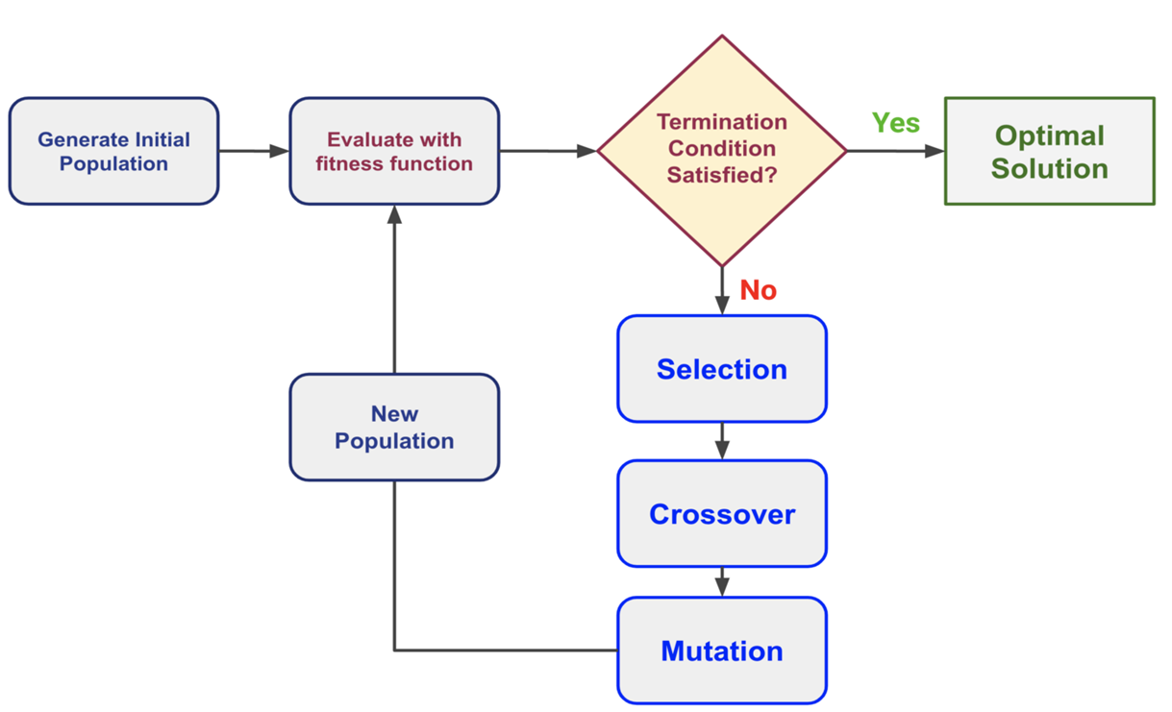
Simplified flowchart of genetic algorithm

Slide 16
4. Analysis and optimization of genetic algorithm for desire purpose
In this step we analyse our algorithm to know the values of important parameter in the order to understand nature of other algorithm
There are various terms associated in analysis of Genetic Algorithm :-
Number of node (city)
Population size (pop size)
Elite size
Mutation rate
Number of Generations

Slide 17
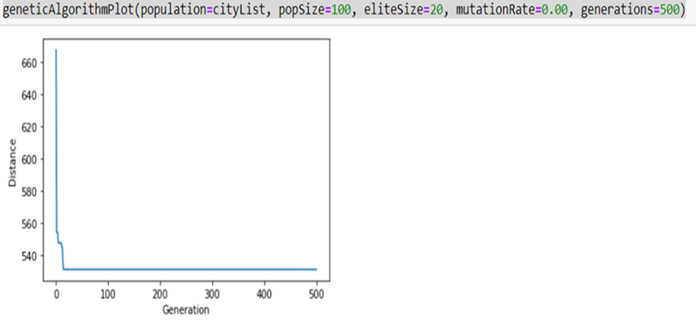
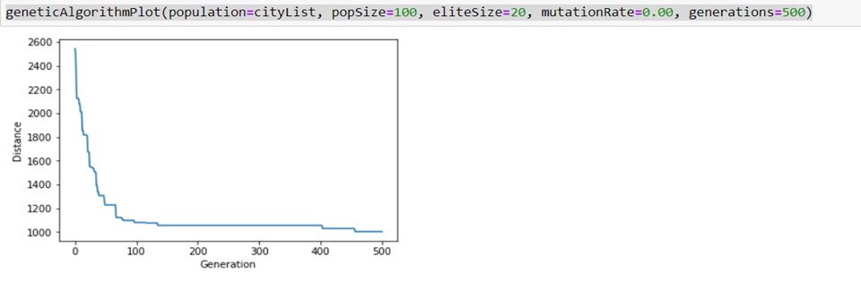
1) 1. Number of nodes (City)
Analysis of number of nodes (keeping other parameters constant)
n=10 :
n=30

Slide 18
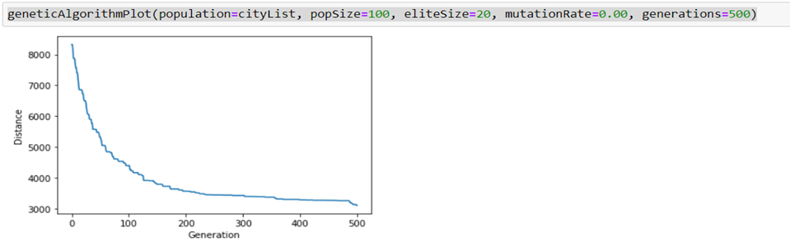
n=90:
Analysis : when we increase the number of nodes it takes more generations to find optimal solution and run time will also increase

Slide 19
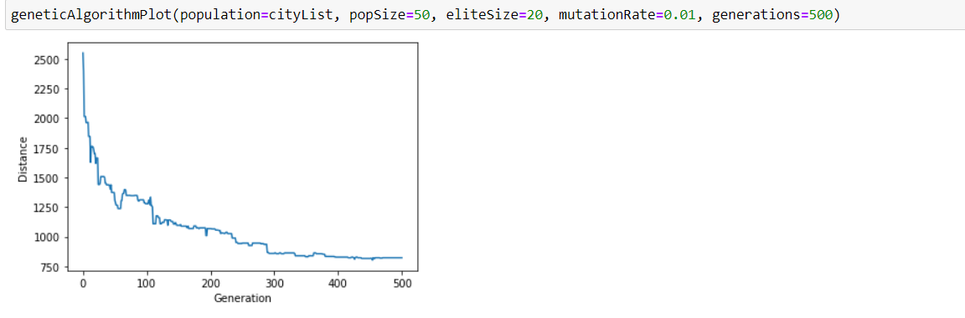
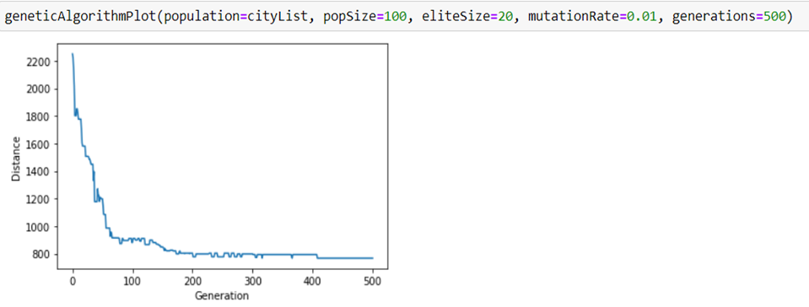
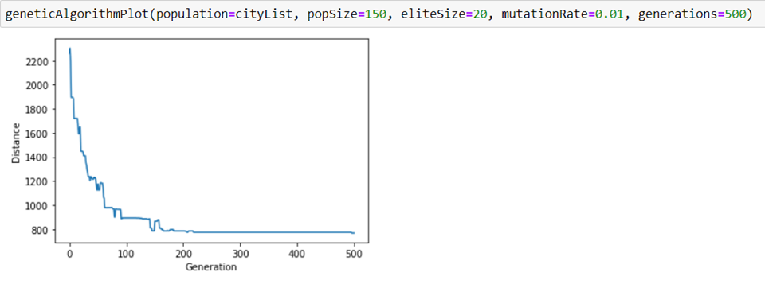
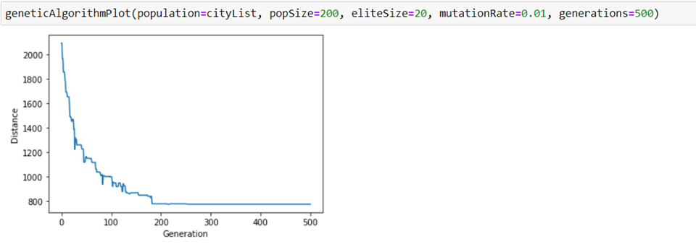
2. Population size (pop size)
pop =50
Pop =100
pop =150
pop =200

Slide 20
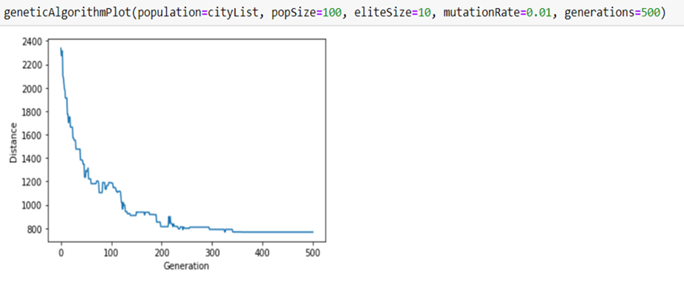
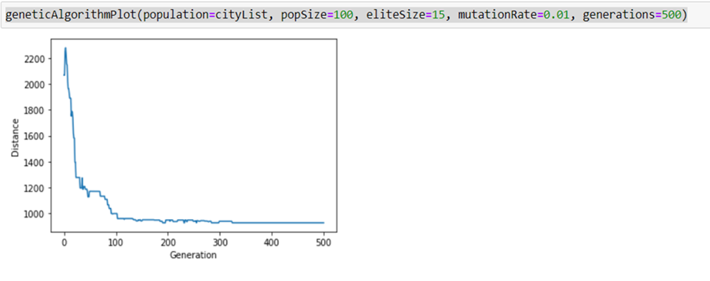
3)Elite size
Analysis : this analysis we conclude that if we increase popsize, optimal solution will occurs at less generations but the run time of program will increase. The total number of generations decrease because in each generations more number of solutions are getting opportunity to prove their fitness but it is not necessarily a good thing because it leads to increase in overall runtime in the program
The number of individuals with the best fitness values in the current generation that are guaranteed to survive to the next generation

Slide 21
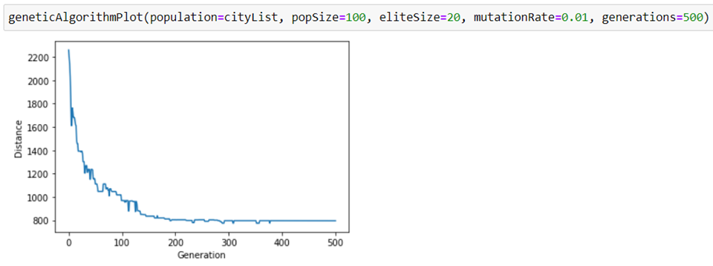
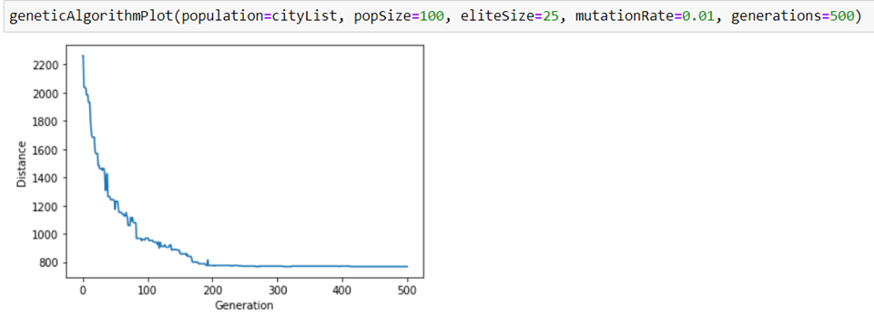
Analysis : we found if we increase eliteSize, optimal solution may occurs at less generations or more generations. But it takes more run time per generation hence the total run time of program will increase

Slide 22
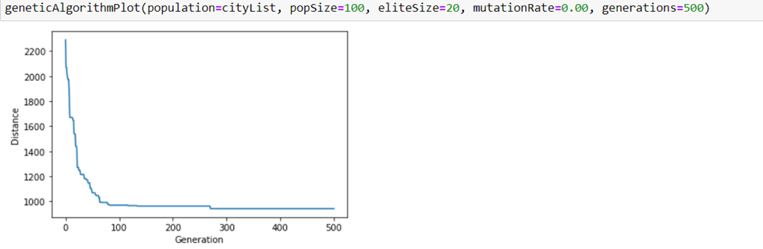
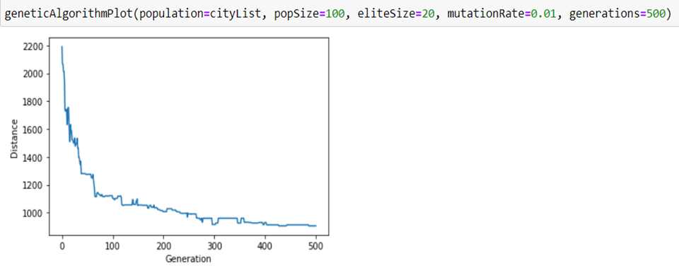
4. Mutation rate
Mutation is a genetic operator used to maintain genetic diversity from one generation of a population of genetic algorithm chromosomes to the next. It is similar to biological mutation . When crossover in GA produce offspring (new solutions) by generating mixtures of the information of two known solutions, mutation is the operator that aim to exploit new areas of the search space in order to escape from local optimal

Slide 23
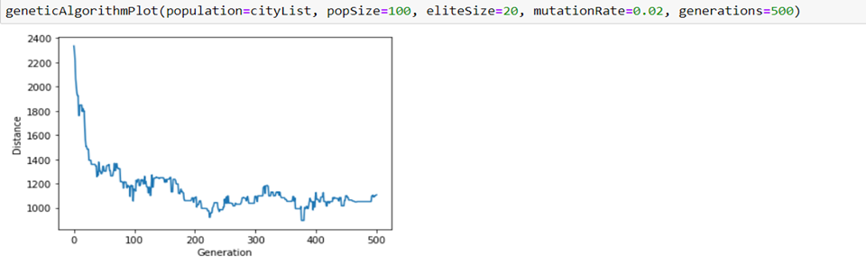
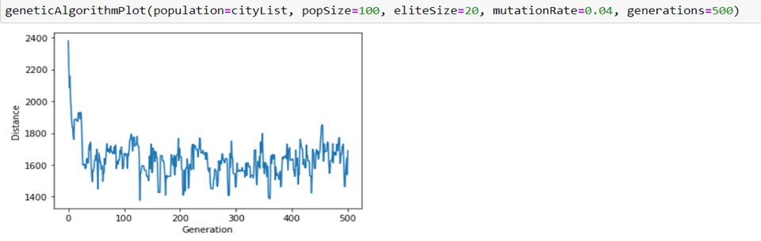
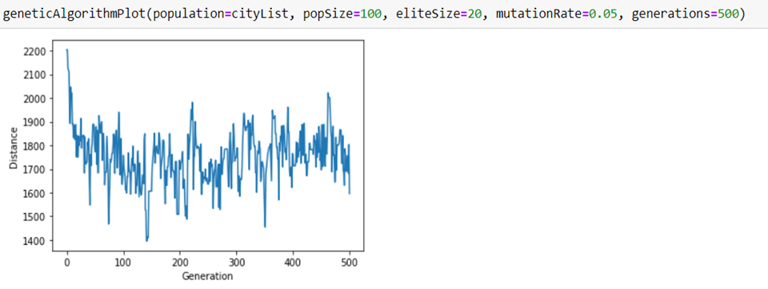

if we increase probability of mutation,the solution population will newer combinations, but this stop algorithm to reach to a solution
Also if we reduce the mutation then we get a smooth curve .

Slide 24
Selection of configuration for our product .
The target user of our software are small businesses , those who have limited resources .
Our target is to write a program which gives best performance for 30-50 nodes .
Our selected cofigurations are
generations = 500
Population size = 100
Elite size= 20
Mutation rate =0.01

Slide 25
Hardware Used
5 .Building user friendly interface
Processor –intel i5 10th Generation
RAM – 8 GB

Slide 26
Software Used
Python
IDE used -VS Code
Library Used
Dearpygui
Numpy
Pandas
PyInstaller

Slide 27
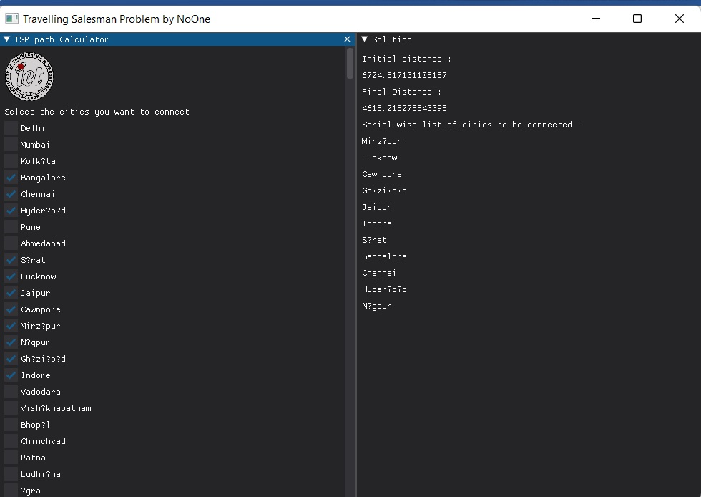
Software Screenshot

Slide 28
How the software works:-
In the UI select the cities you want to connect then it will show the city of list to be travelled serial wise.
The program uses genetic algorithm to solve this problem .
Internally we have feed the locations of the cities in the program it calculates distance by haversine formula then applies the genetic algorithm.

Slide 29
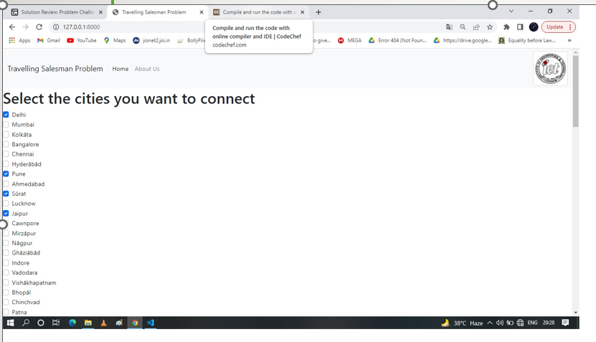
Web application

Slide 30
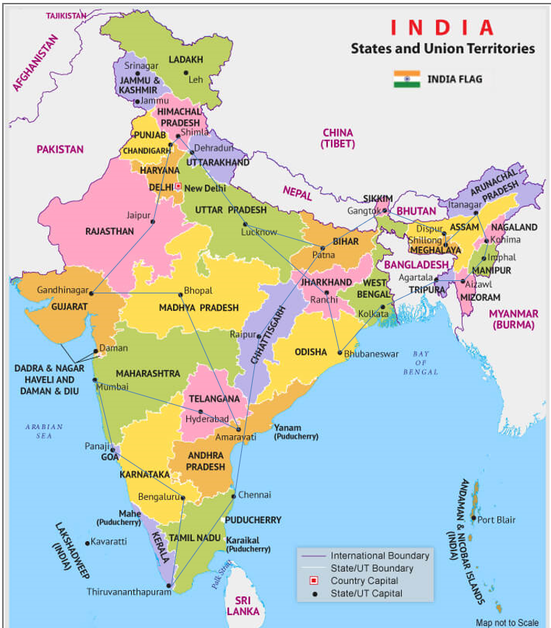
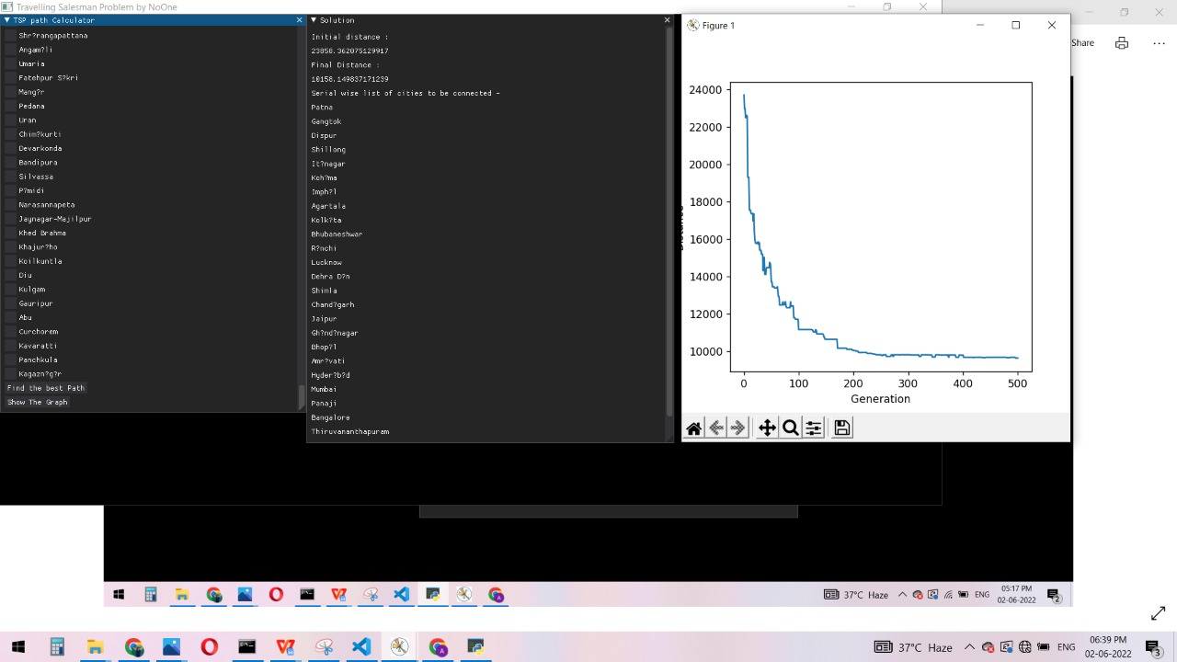
6) Application of our product on real life problems
Optimum tour route that connect all state capital of india .

Slide 31
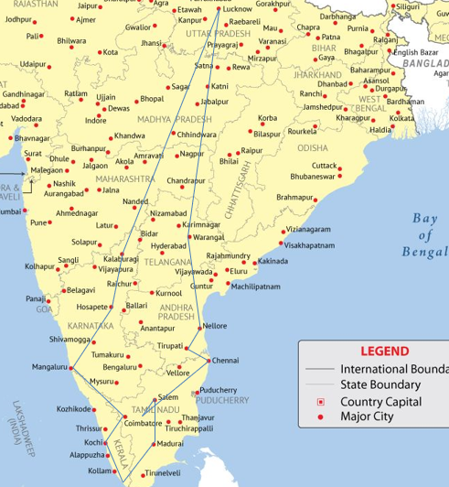
South Indian temple tour plan : tour of prominent south india temples starting from lucknow .
These temples 18 are as follows :
1. Padmanabhaswamy Temple – Trivandrum
2. Ramanathaswamy Temple – Rameshwaram
3. Ranganathaswamy Temple – Trichy
4. Venkateshwara Temple – Tirupati
5. Chennakeshava Temple – Belur
6. Arunachaleswar Temple – Thiruvannamalai
7. Brihadeeswarar Temple – Thanjavur
8. Meenakshi Temple – Madurai
9. Guruvayur Temple – Guruvayur
10. Kailasanathar Temple – Kanchipuram
11. Ekambareswarar Temple – Kanchipuram
12. Sarangapani Temple – Kumbakonam
13. Vadakkunnathan Temple – Thrissur
14. Annapoorneshwari Temple – Horanadu
15. Shore Temple – Mahabalipuram
16. Sivagiri Temple – Varkala
17. Mahabaleshwar Temple – Gokarna
18. Parthasarathy Temple – Aranmula

Slide 32


CEO Problem : suppose there is a ceo who need to visit his 10 factory location in 10 different cities in india

Slide 33
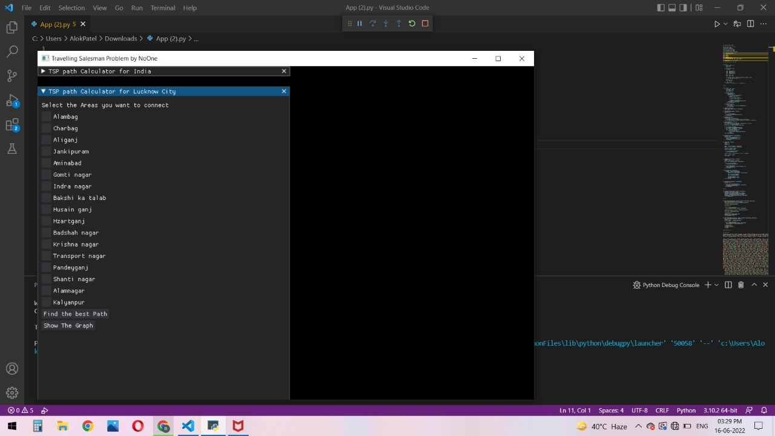
SOFTWARE FOR DELIVERY IN LUCKNOW

Slide 34
CONCLUSION
Genetic algorithm is suitable approach for optimizing the touring problem .
We made a software
A genetic algorithm based software can be made to facilitate the tour related decision making of small and medium businesses that can effectively reduce their operational cost .

Slide 35
FUTURE PLAN FOR OUR PROJECT
To work towards intra platform compatibility : web application , android application ,ios app.
To add geometrical coordinates of local places in program to make it operational at with city level.
To integrate our program to drone delivery system .
To implement the solution of Vehicle Routeing Problem with GA.

Slide 36
REFERENCES
Survey of Methods of Solving TSP along with its Implementation using Dynamic Programming Approach-Chetan Chauhan(International Journal of Computer Applications)
Applying a genetic algorithm to the traveling salesman problem -Lee Jacobson ,(https://www.theprojectspot.com/tutorial-post/applying-a-genetic-algorithm-to-the-travelling-salesman-problem/5)
Landmark Based Shortest Path Detection by Using A* and Haversine Formula-Prof. Nitin R.Chopde , Mr. Mangesh K. Nishat
Evolution of a salesman: A complete genetic algorithm tutorial for Python – Eric sholtz, (towardsdatascience.com)

